Slide 1
Collision Avoidance Robot
Omar Ra’fat
Mustafa Kamel

Slide 2
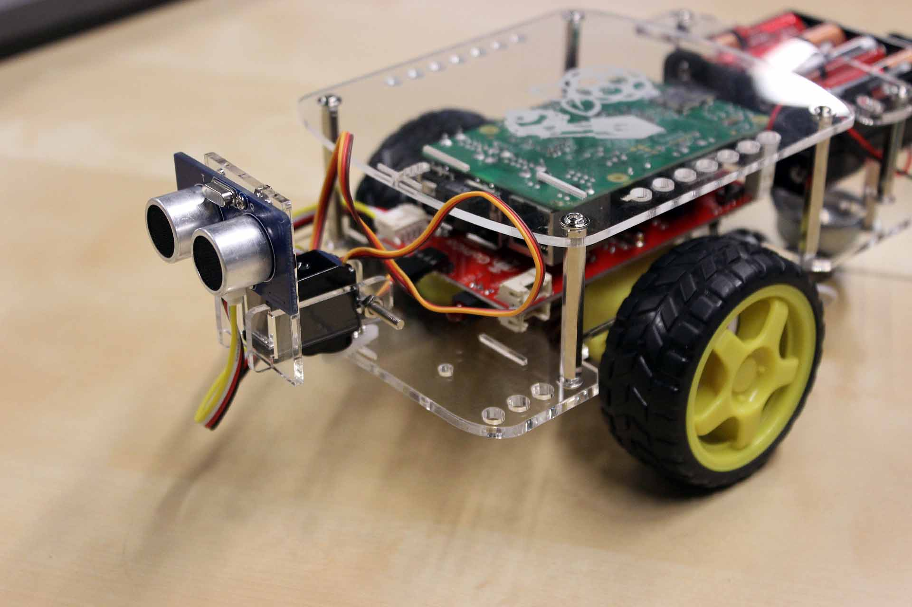
Description

Slide 3
Flowchart
Start
Read Duration
Calculate Distance
D > 15
Move Forward
Turn Right
EXIT

Slide 4
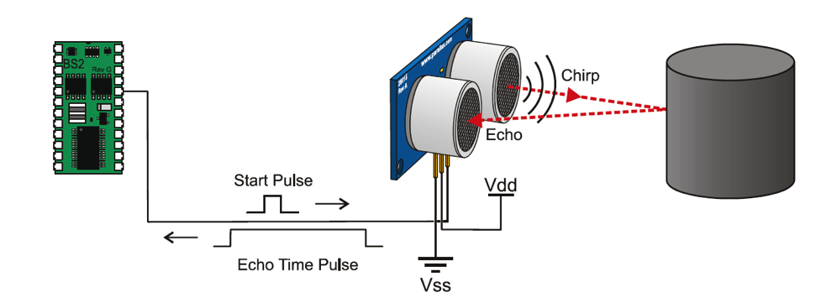
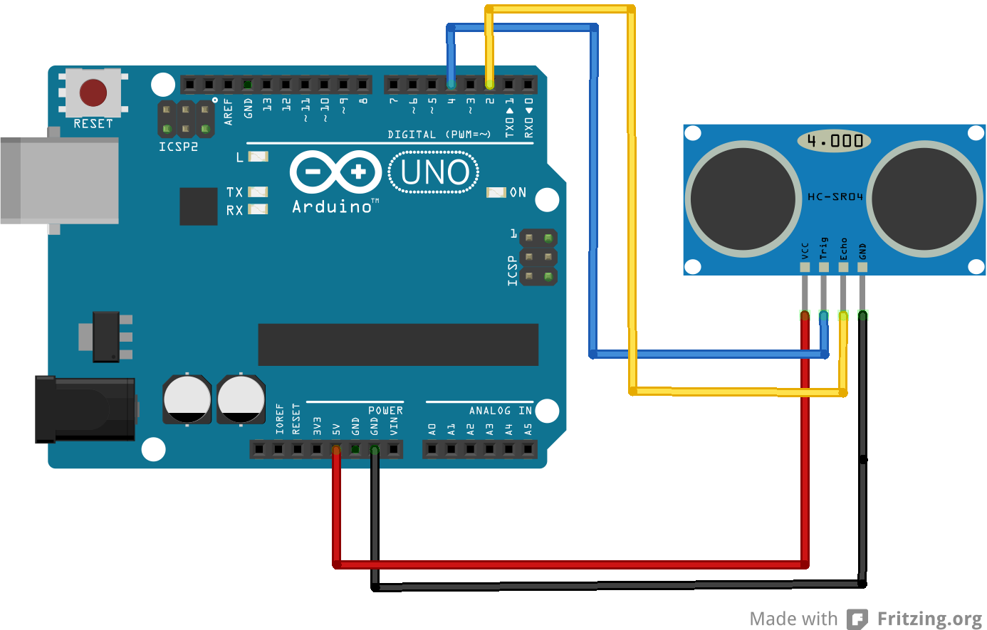
Theory of work

Slide 5


Implementation
Setup method initiates the code
Distance method measures the distance
Loop method runs the code
IC L293D is used as an actuator for the motor

Slide 6
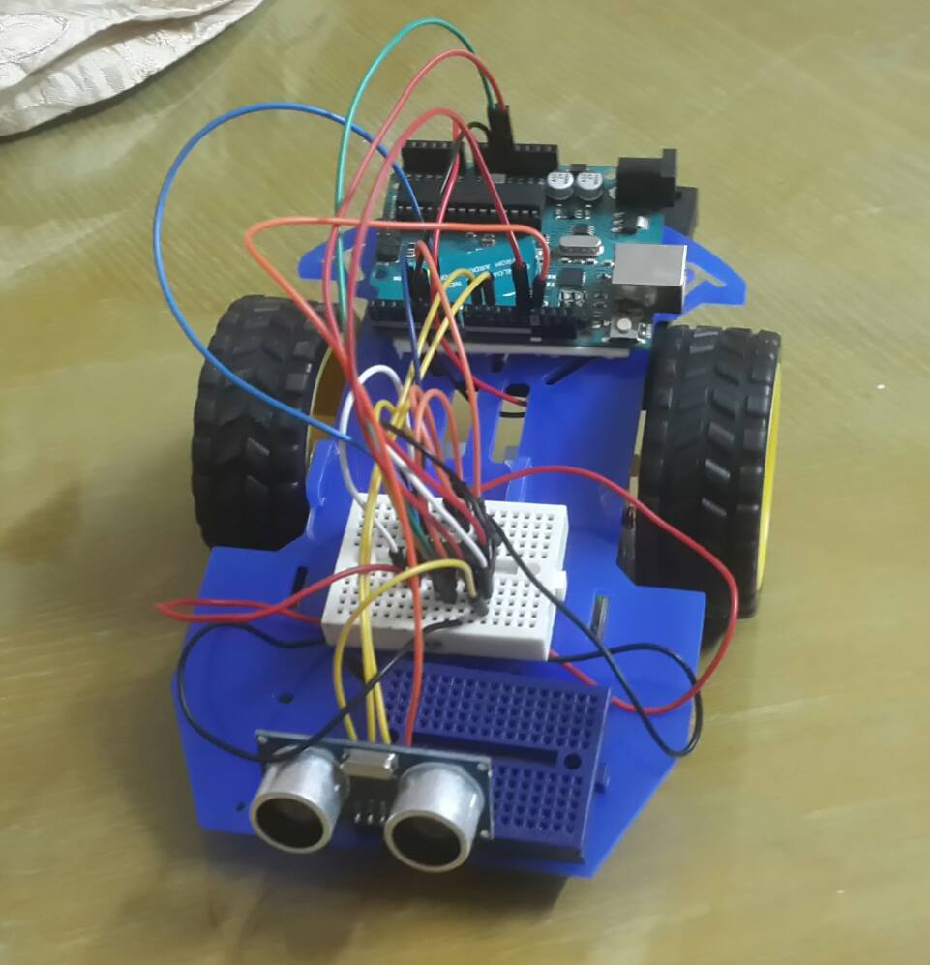
Conclusion

Slide 7
Thanks

